Slide 1
BIBLE BASICS 101
Part One Bible Overview
Part One Bible Overview
September 5, 2021
© 2021 Bob Highlands III
A four-week course to start you on a path to better understanding your Bible.
Notes:
Seems there were these three professionals sitting around talking about the oldest profession.
The Doctor says, “Well, the Bible says that God took a rib out of Adam to make woman. Since that clearly required surgery, then the oldest profession is surely medicine.”
The Engineer shakes his head and replies, "No, no. The Bible also says that God created the world out of void and chaos. To do that, God must surely have been an engineer. Therefore, Engineering is the oldest profession.”
The Politician smiles smugly and leans discreetly forward,” he says, "but who do you think created the Chaos?”
Baseball is mentioned in the Bible. It starts with the words
IN THE BIG INNING
Who played in the game
Eve stole first
Adam stole second
The parodical son struck out
What kind of cell phone did Delilah use?… Samson
Leaving the bad Bible Jokes behind I want to look at the Bible like a puzzle today. Now, I am not a fan of crossword puzzles, or jigsaw puzzles. But, I am a fan of the puzzle that is the Bible. I will explain as we go along.

Slide 2
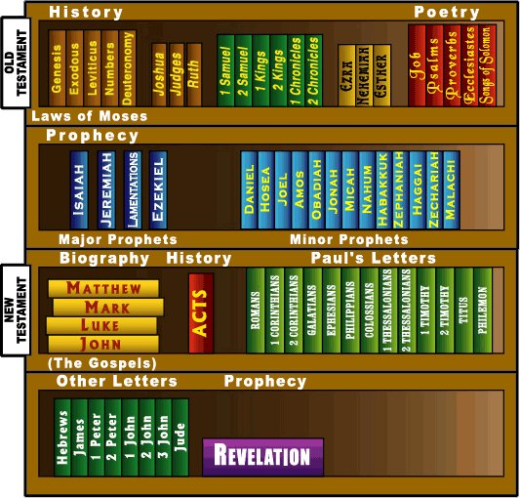
Essential FACTS
The Bible is made up of 66 Individual books, The Old Testament has 39 books and the New Testament has 27 books.
Over 40 authors contributed to the Bible.
The Bible is about 611,000 WORDS long in the original languages.
The average Bible has 1,200 PAGES.
The Bible was written in 3 LANGUAGES. Hebrew, Aramaic and Greek.
The longest book is JEREMIAH and the shortest is 2 JOHN which can be read in about one minute.
The Bible is over 3,000 years old.
There are at least 185 SONGS.
Notes:
Over 40 authors contributed to the Bible. The authors’ statuses in life range from being kings, peasants, prophets, philosophers, fishermen, poets, statesmen, scholars, a doctor musicians, and several pastors.
Those languages are Hebrew, Aramaic, and Greek. Most of our Old Testament was written in Hebrew, which was the language the original readers spoke. A few bits of the Old Testament were written Aramaic (Ezra and Daniel). The New Testament was written in Greek, the commonly-spoken language of the time.
And 185 is a bare minimum—that’s only if you count the portions of Scripture that are specifically labelled as “song,” “psalm,” “dirge,” or “chant.”

Slide 3
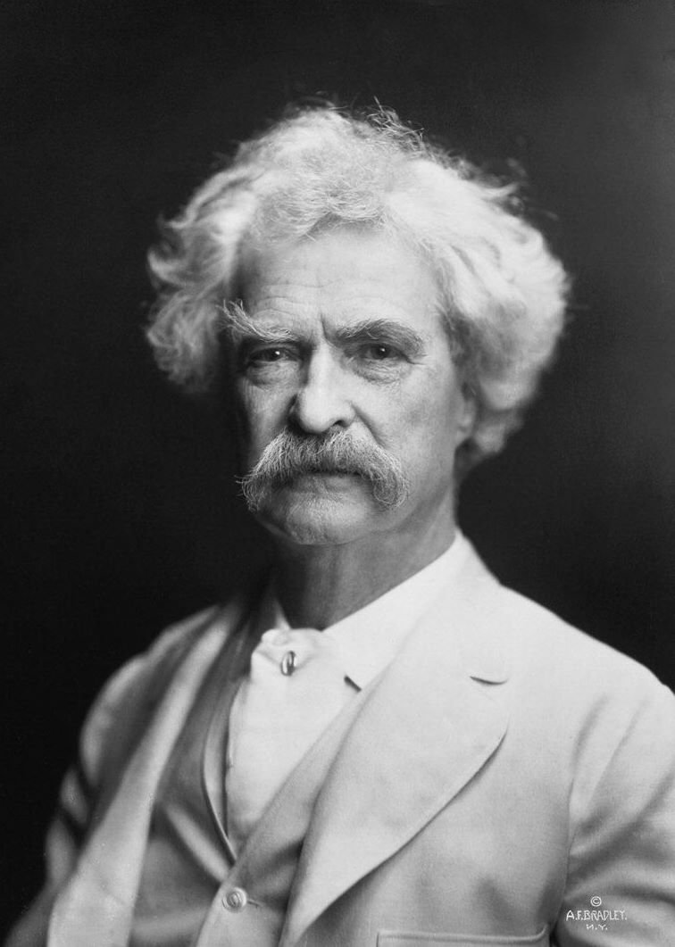
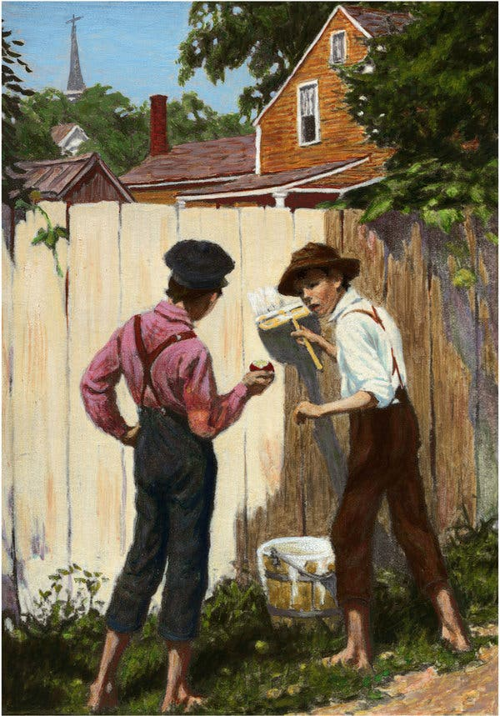
So True
It ain't those parts of the BIBLE that I can't understand that bother me, it is the parts that I do understand.- _{Mark Twain}

Slide 4
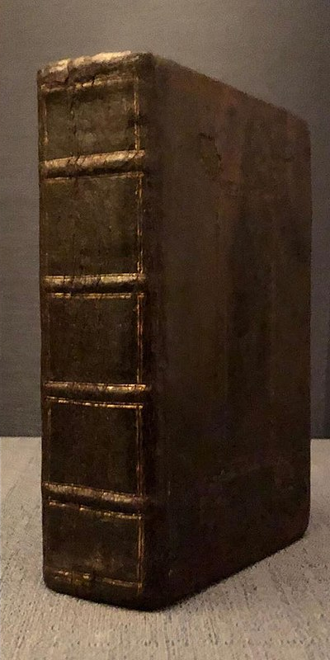
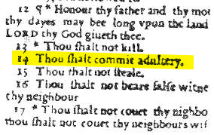
Whoops…NOTeee
In 1631, a publishing company published a Bible with the typo “Thou Shalt Commit Adultery.” Only 15 of these Bibles, known as the “SINNERS’ Bible” “Adulterous Bible” “Wicked Bible” exist today.
Notes:
Over the last 15 years copies have sold for $46K and $57K.

Slide 5
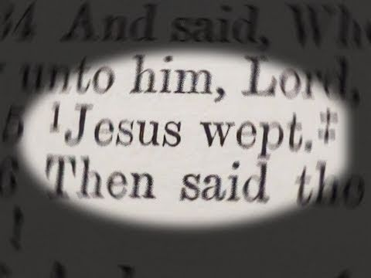
Interesting Facts
The shortest verse in the Bible is John 11:35 – “Jesus WEPT.”
Esther 8:9 is the longest VERSE in the Bible. (53 words)
Psalm 119 is the longest CHAPTER in the Bible. _{(176 vss.)}
There are 1,189 CHAPTERS in the Bible with 31,102 verses.*
Methuselah is the oldest person in the Bible who died at the age of 969.
The Bible has been translated to over 690 languages.
Notes:
*Since it is an even number the middle is between Psalm 103.1 and Psalm 103.2

Slide 6
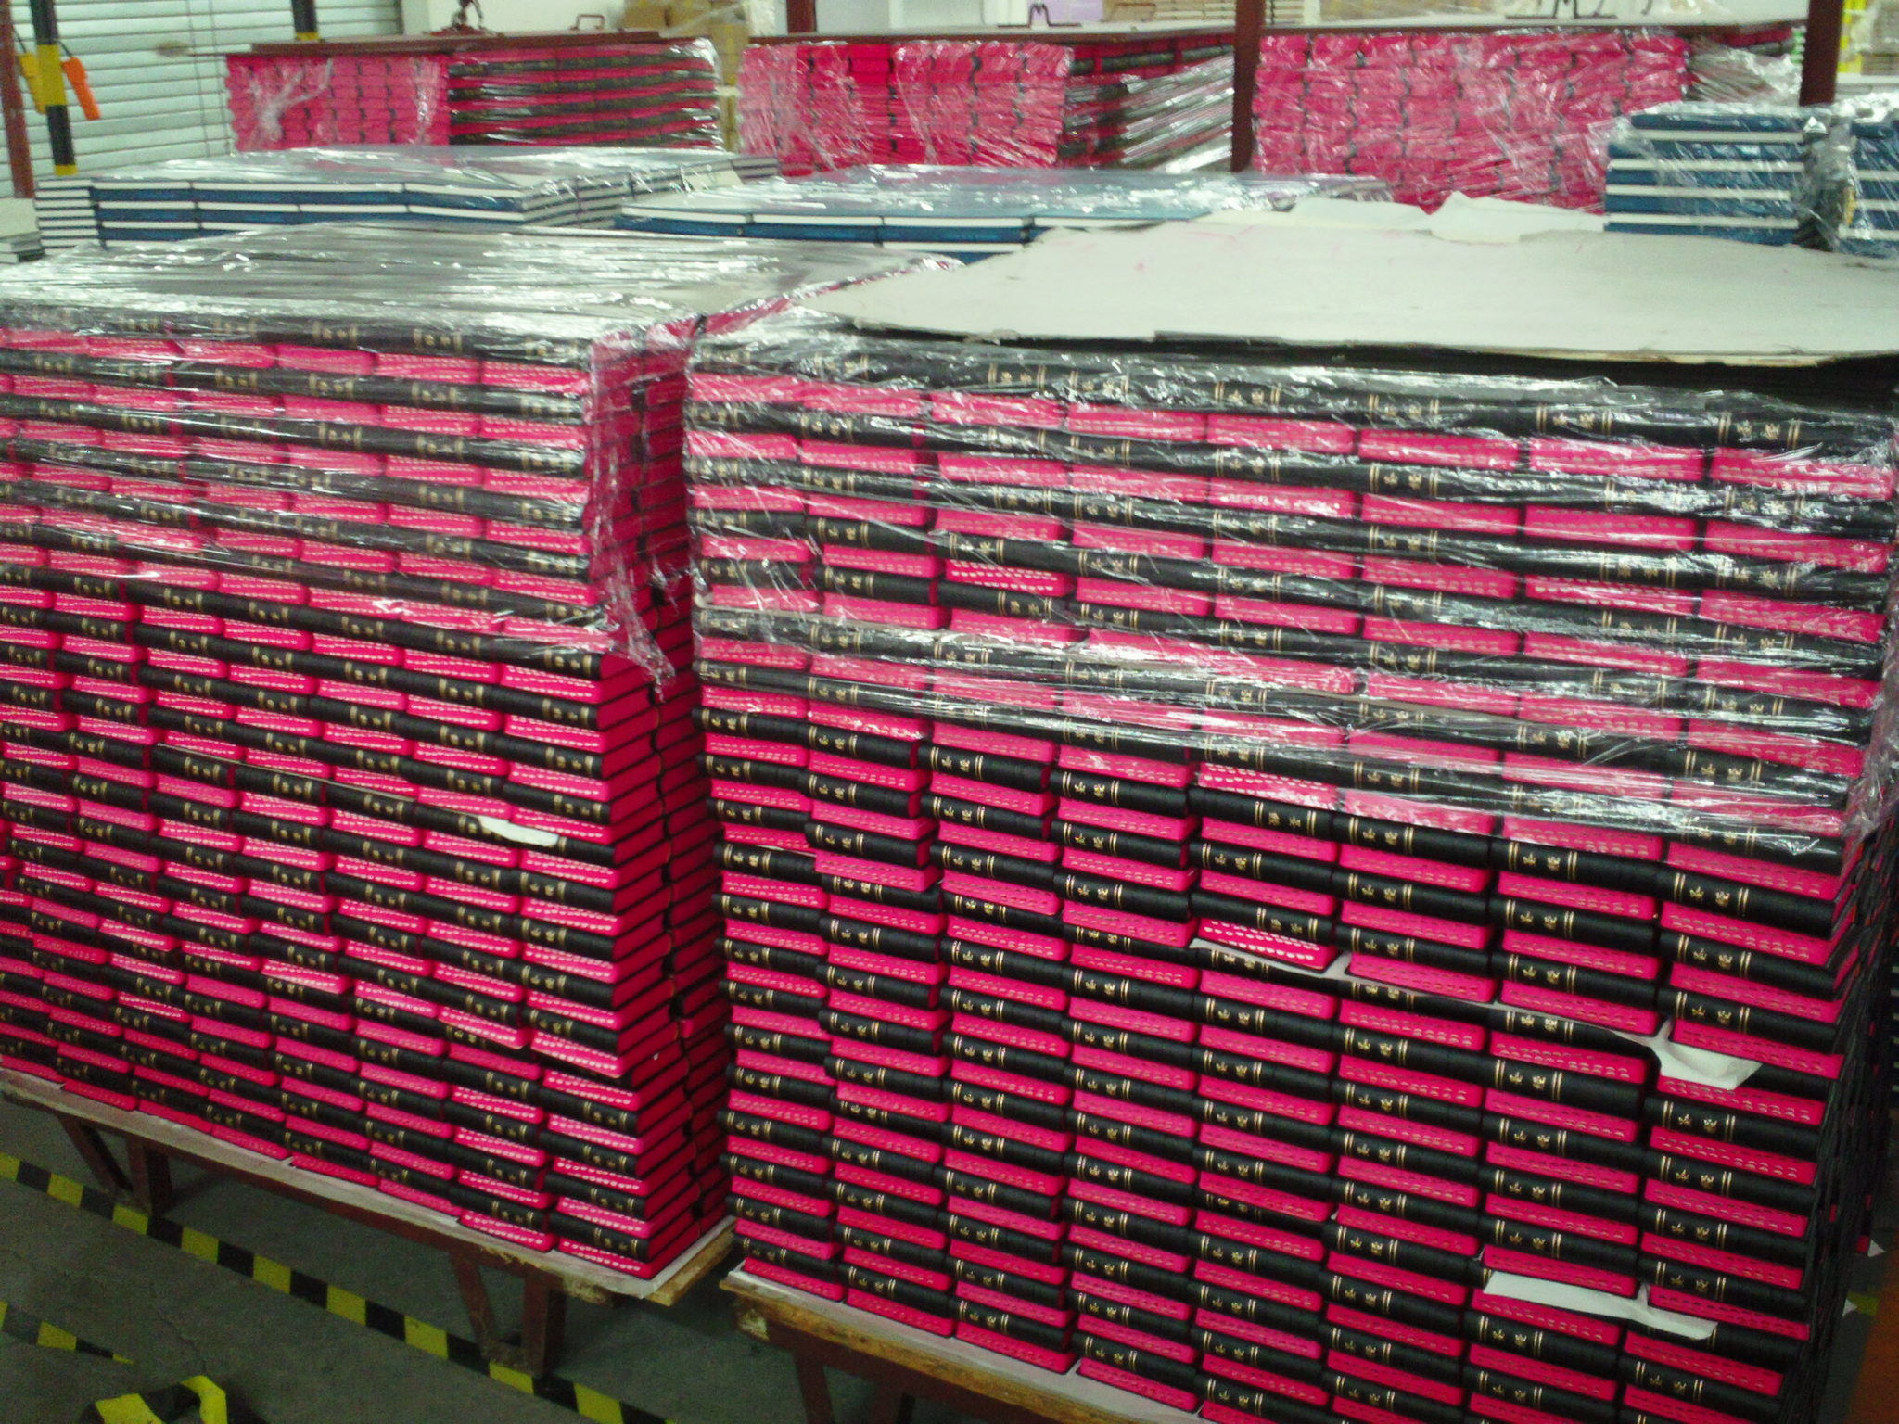
Interesting Facts
Isaiah 8.3 the LONGEST word is a person’s name.(18 Letters) “Mahershalalhashbaz“
The O.T. took over a 1,000 years to write and the N.T. between 50-75 years.
The Bible is sold over 100 MILLION times a year.
CHINA leads the world in Bible production. (but not reading)
93 women spoke in the Bible, the Bible only recorded 49 names for these women. Women spoke a total of 14,056 words in the Bible which is approximately 1.1% of the Book.
Notes:
Maher-shalal-hash-baz, meaning “the spoil speeds; prey hastens.” It was prophetic concerning the coming plundering of the country by Assyria.

Slide 7
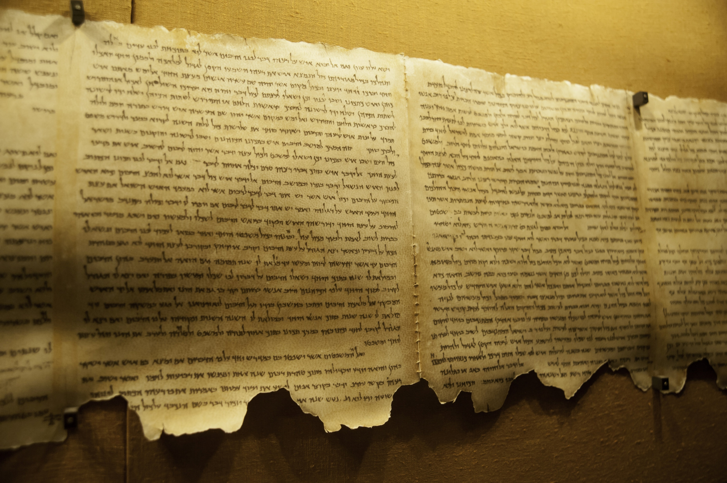
Who Knew?
The word “BIBLE” is from the Greek ta biblia, which means “the scrolls” or “the books.” The word is derived from the ancient city of Byblos, which was the official supplier of paper products to the ancient world

Slide 8
Did you catch that one?
The 1999 blockbuster The Matrix heavily draws from the Bible. The rebel base in the movie is known as ZION, the primary ship is named NEBUCHADNEZZAR (after the Biblical king), and the film’s Judas character is named CYPHER in reference to the name LUCIPHER.

Slide 9
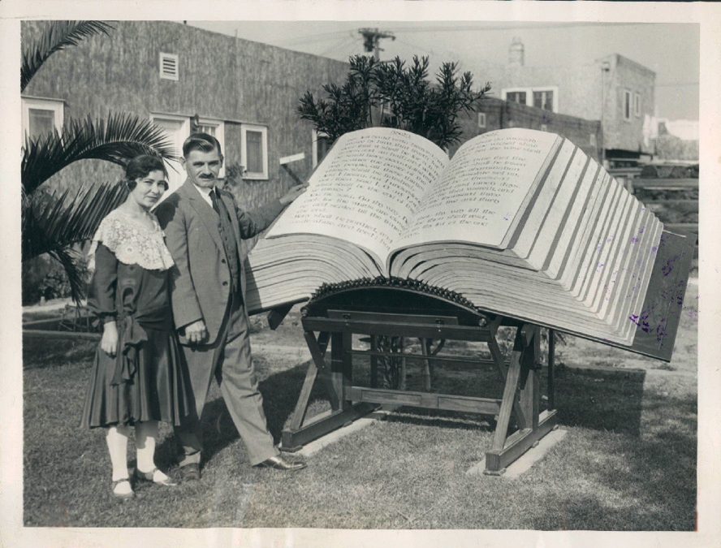
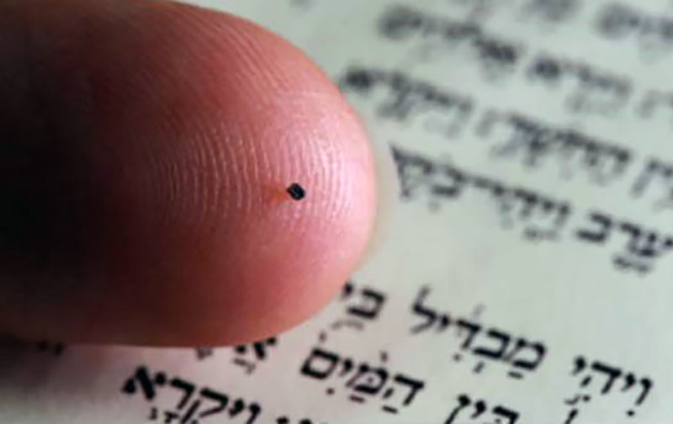
Just what you need.
The world’s SMALLEST bible can fit on the tip of a pen. Scientists etched the 1.2 million letters of the Old Testament on a tiny silicone disk, which they call the Nano Bible.”
The world’s LARGEST Bible weighs 1,094 pounds. Built by Louis Waynai in 1930, the book is 43.5 inches tall and a laid open width of 98 inches.
Notes:
They make a slightly bigger version, 5mm by 5mm that has the NT in Greek and is contained in a necklace. The electron microscope needed to read it comes extra. ( I found one for 1,035.00 on the internet but nothing on eBay so you cannot use PayPal.

Slide 10
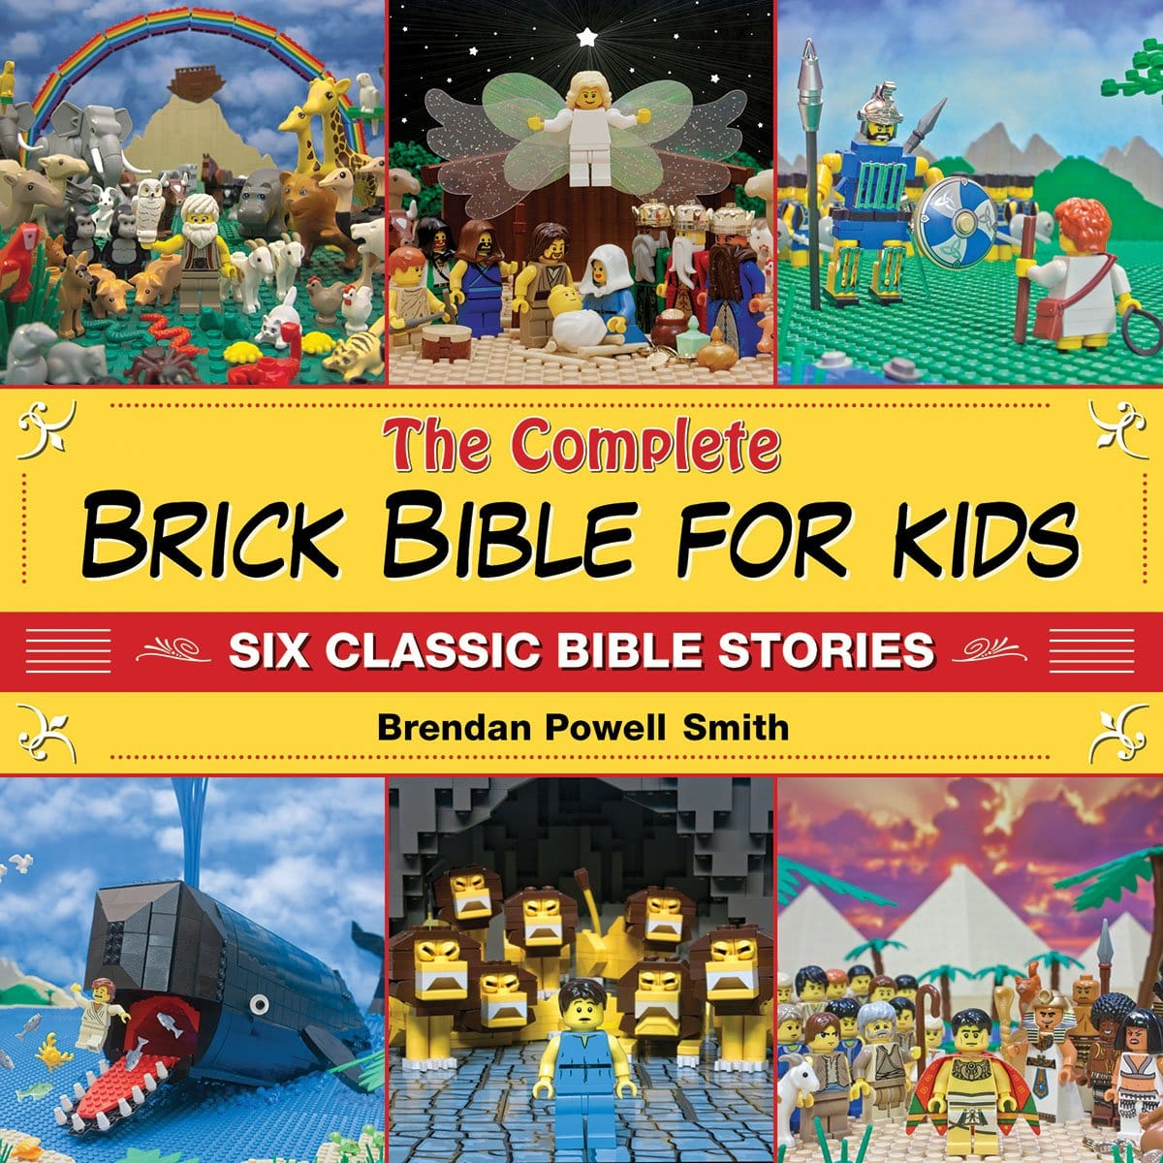
Build Your Puzzle
In 2011, author Brendan Powell Smith published The BRICK Bible, which contains recreations of Bible scenes— all with LEGO bricks.
Sam’s Club promptly banned the book for objectionable images.

Slide 11
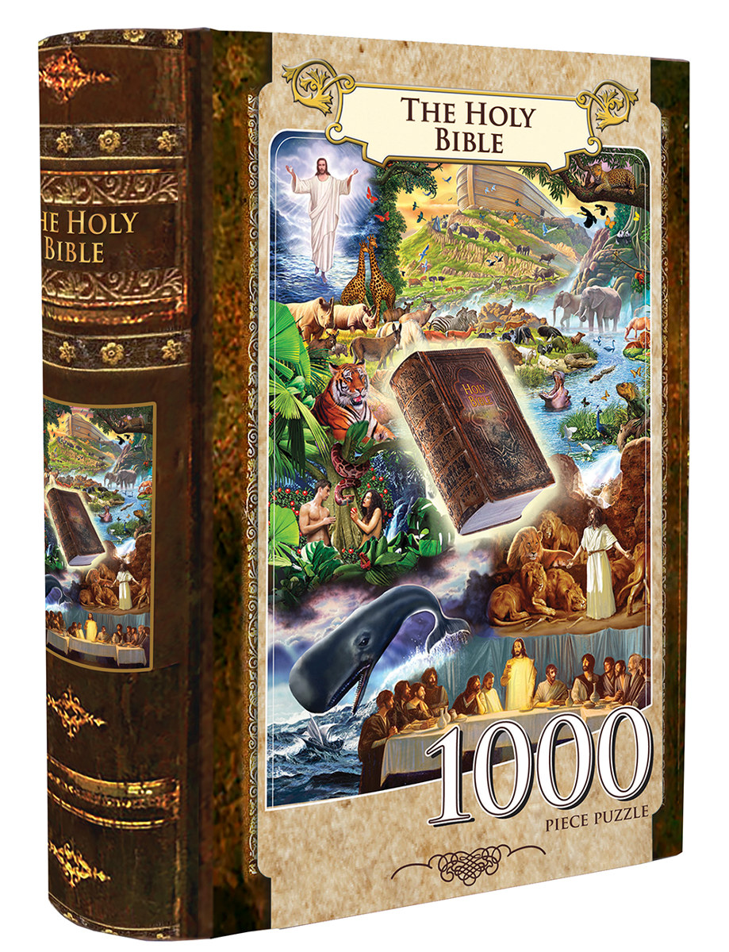
The Bible Puzzle
The Bible has thousands of parts (VERSES) that are designed to show us a bigger picture.
No single part is the PICTURE.
There are RULES that make putting the Bible together and understanding it.
There are no short cuts, but you CAN understand it.
All the pieces are DESIGNED to fit together without pressure.
Notes:
Scripture interprets Scripture
Easy interprets the difficult
Nothing out of context
Jesus is BOSS!

Slide 12
The Bible Puzzle
The EDGES show us the limits of what we can know now.
The stories are about REAL humans as they interact with God in their daily lives.
The O.T. is there so we can UNDERSTAND the N.T.
Without JESUS the O.T. has no value beyond showing us how lost we really are.
The Bible is about POSITIVE and NEGATIVE relationships and their consequences.
Notes:
God exposes humanity for who we are. He also shows what we can become with his help.
Judah and Tamar Genesis 38
Twins Perez and Zerah
Judah, Tamar and Perez are all in the linage of Jesus. Matthew 1.3
How about Matthew 1.6 And* David was the father of Solomon by* the wife of Uriah,

Slide 13
The Bible Contrast
The Bible is best seen when you understand the contrast it presents.
EVIL vs. GOOD
PHYSICAL vs. SPIRITUAL
TEMPORARY vs. ETERNAL
PUNISHMENT vs. REWARDS
JUSTICE vs. MERCY
LAW vs. GRACE
Notes:
People who say they don’t believe in evil, usually are.

Slide 14
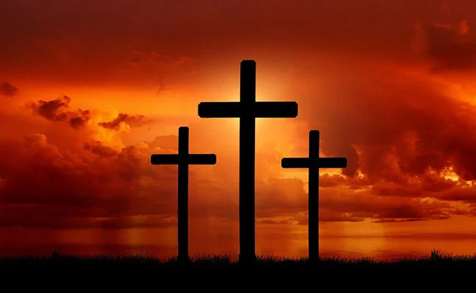
The Bible’s Purpose
The Bible is God revealing Himself to humanity to reestablish a RELATIONSHIP through His son JESUS.
Notes:
This is why we study the Bible. This is our guide and our salvation. This is who we follow to discover the narrow path that lead to eternal life. This is our hope, mercy, grace, promise.

Slide 15
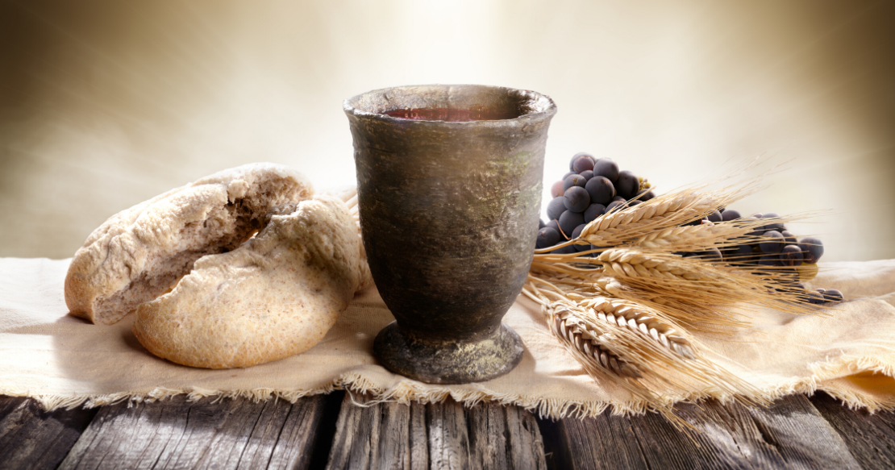
Communion & Prayer

Slide 16
Bible Study Help
CHOOSE A WORK AREA THAT FITS THE PUZZLE
LIGHTING IS THE KEY TO ASSEMBLING A PUZZLE FAST.
TURN ALL PUZZLE PIECES PICTURE SIDE UP
ASSEMBLING THE BORDER
ASSEMBLING THE CENTER
KEEP WORKING ON IT AND DON'T GIVE UP*
31,103 PIECES**
Notes:
*https://themissingpiecepuzzle.com/blogs/jigsaw-puzzle-talk/how-to-assemble-a-jigsaw-fast Accessed August 31, 2021
** As of 2014, the Old Testament is generally recognized to have 23,145 verses, while the New Testament has 7,958 verses. This gives the Bible an accepted total of 31,103 verses. However, the exact number of verses varies depending on the Bible edition and religious tradition.
6 tips for assembling a puzzle that we can apply to our Bible reading and study.
Be deliberate in your study. You need a place where you can read, write and pray.
Ask God to show you the truth of what you are reading. Let His light shine in your Bible reading.
A great book is one that give you a background of each book in the Bible. So you can see what is happening. Or go to the Bible Project and they have a quick outline in video form for each book of the Bible.
Start with the easier parts. Gospels are a great place. No do not think you are ready to take on Isaiah, Ezekiel, Daniel and don’t you dare start in Revelations.
Expand out to Acts, Genesis and other books that are straight forward.
This will be a lifetime task. You will never complete all there is to learn. There are too many pieces to put together to ever finish.

Slide 17
Announcements & Upcoming events
September
An overview of the Bible for beginners. 4 Sundays
SUPPORT SONRISE
Sonrisechurch.com
More information
Sonrisechurch.com

Slide 18
The Bible’s Purpose
The Bible is God revealing Himself to humanity to reestablish a relationship through His son Jesus.

