Slide 1
Christian Pedestrianism What it takes to Walk The Walk 1st John 1.5-2.6 Message 2 0f 8
© 2023 Bob Highlands III
Notes:
Choosing where to walk
Race Walking for the Lord
Walking according to the rules
How to Walk and not fall down

Slide 2
1st John 1.5 thru 2.6 NASB
This is the message we have heard from Him and announce to you, that God is Light, and in Him there is no darkness at all. If we say that we have fellowship with Him and yet WALK in the darkness, we lie and do not practice the truth; but if we WALK in the Light as He Himself is in the Light, we have fellowship with one another, and the blood of Jesus His Son cleanses us from all sin.

Slide 3
If we say that we have no sin, we are deceiving ourselves and the truth is not in us. If we confess our sins, He is faithful and righteous to forgive us our sins and to cleanse us from all unrighteousness. If we say that we have not sinned, we make Him a liar and His word is not in us.

Slide 4
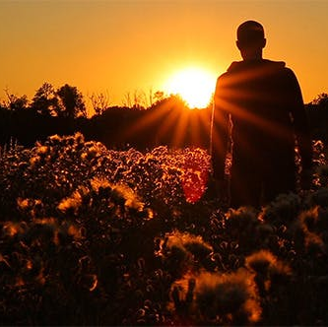
My little children, I am writing these things to you so that you may not sin. And if anyone sins, we have an *Advocate with the Father, Jesus Christ the righteous; and He Himself is the propitiation for our sins; and not for ours only, but also for those of the whole world.

Slide 5
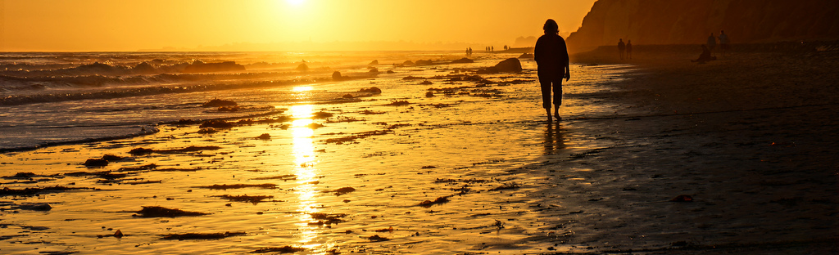
By this we know that we have come to know Him, if we keep His commandments. The one who says, “I have come to know Him,” and does not keep His commandments, is a liar, and the truth is not in him; but whoever keeps His word, in him the love of God has truly been perfected. By this we know that we are in Him: the one who says he abides in Him ought himself to WALK in the same manner as He WALK.

Slide 6
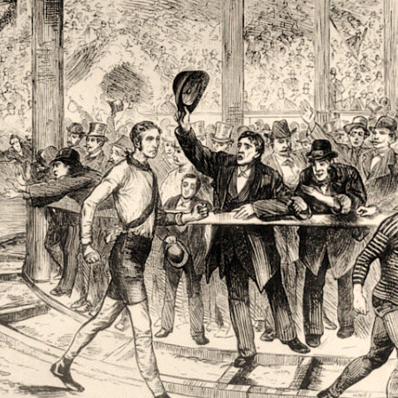
Pedestrianism
Race Walking has been an Olympic event since 1904 and will include a two-person, mixed-team Marathon in the 2024 Olympic event in Paris.
In the 19th century, 1,000 KMS races lasting 6 days were held inside special arenas. (that is 621.4 miles)
BASIC RULES:
One foot must always be touching the ground in a HEEL-TO-TOE rule, or you get a penalty.
The front leg must remain STRAIGHT as the body passes over it, or you get a penalty. (3 penalties and your OUT!)
Notes:
https://olympics.com/en/news/all-you-need-to-know-about-race-walking
In the 1870s, racewalking was the 2nd biggest betting sport in the USA.
The longer form of "ultra marathon" walking featured in the popular press and in the decade after the American Civil War in the United States was a source of fascination. Edward Payson Weston, a reporter for the New York Herald won a $10,000 prize by walking 1,136 miles (1,828 km) from Portland, Maine, to Chicago in 30 days in 1867
One of the most famous pedestrians of the day was Captain Robert Barclay Allardice, called "The Celebrated Pedestrian", of Stonehaven. His most impressive feat was to walk 1 mile (1.6 km) every hour for 1000 hours, which he achieved between 1 June and 12 July 1809. The feat captured the public's imagination and around 10,000 people came to watch over the course of the event.[6] During the 19th century, attempts to repeat the athletic challenge were made by many pedestrians, including George Wilson who attempted to walk 1,000 miles (1,600 km) in 480 hours in 1815 but was arrested after 3/4 of the distance for disturbing the peace
https://en.wikipedia.org/wiki/Pedestrianism Accessed April19, 2023

Slide 7
*Choosing where to walk
Choose to WALK in the LIGHT of God
Defined by our FELLOWSHIP with HIM
Shows in our FELLOWSHIP with other BELIEVERS
We are covered by the BLOOD and cleanse from ALL sin.
Choose to WALK in the DARKNESS of Sin
Defined by the LIE we tell OURSELVES
Defined by the PRACTICE of rejecting TRUTH
We are EXPOSED without the BLOOD and living in sin.
Choose GOD without DARKNESS or Choose the DARKNESS without GOD.
Notes:
* This is not written to the world. It is written to believers. This is not some general text to everyone everywhere. It is designed to force people to see the truth and to make choices based on that truth.
A single candle flame is visible to the naked eye from up to 30 miles. With the curve of the earth it would be limited to 3.1 miles on a straight line. This was why blackout curtains during WWII were so important. An enemy pilot could see even the smallest amount of light.
Darkness is walking where not even a candle flame of truth is visible.

Slide 8
Choose what to believe
Choose to believe the LIE.
There is no sin, and you DECEIVE yourself, but you cannot fool God.
Choose to believe the TRUTH.
Confess your sins and be CLEANSED from unrighteousness by God.
Is God a LIAR because we refuse to believe His WORD or is His WORD still TRUE?
Notes:
Remember that Gnostics saw the world and the physical as sinful. They denied personal sin. They rejected the teachings that Jesus died for our personal sins. He was a teaching phantom or spirit that was guiding them toward

Slide 9
BUT when you need it Choose to ask for help
The GOAL is clear, a life without SIN.
Notes:
Acts 20.24 However, I consider my life worth nothing to me, if only I may finish the race and complete the task the Lord Jesus has given me—the task of testifying to the gospel of God's grace.

Slide 10
Choose to ask for
Ask the ADVOCATE, Greek paraklētos or the one CALLED ALONGSIDE.
Literally to be CLOSE-BESIDE or a representative or legal advocate who decides for your cause.
Jn. 14.6 The Holy Spirit is Another HELPER that is with you forever.
Jn 14.26 H.S. will TEACH you all things and help you REMEMBER the truth.
Jn. 15.26 H. S. will TESTIFY about Jesus.
Jn. 16.7 He is here in Jesus’ place, CONVICTING concerning sin, righteousness, and judgment.
1 Jn. 2.1 Jesus is our ADVOCATE in Heaven to plead our forgiveness before the Father.
He is the PROPITIATION* for our SINS. This atoning sacrifice is JESUS.
Notes:
Jn. 14.16 “I will ask the Father, and He will give you another Helper, that He may be with you forever;
Jn. 14.26 “But the Helper, the Holy Spirit, whom the Father will send in My name, He will teach you all things, and bring to your remembrance all that I said to you.
Jn. 15. 26 “When the Helper comes, whom I will send to you from the Father, that is the Spirit of truth who proceeds from the Father, He will testify about Me,
Jn. 16.7-11 “But I tell you the truth, it is to your advantage that I go away; for if I do not go away, the Helper will not come to you; but if I go, I will send Him to you. “And He, when He comes, will convict the world concerning sin and righteousness and judgment; concerning sin, because they do not believe in Me; and concerning righteousness, because I go to the Father and you no longer see Me; and concerning judgment, because the ruler of this world has been judged.
Jn 16.7 “But I tell you the truth, it is to your advantage that I go away; for if I do not go away, the Helper will not come to you; but if I go, I will send Him to you.
1 Jn. 2.1 And if anyone sins, we have an Advocate with the Father, Jesus Christ the righteous;
*Propitiation = atoning sacrifice. Only Jesus has the power to forgive sins. It was His blood, and it is Jesus who advocates for our forgiveness. This sacrifice appeases God’s wrath or judgment. It covers and erases sin.

Slide 11
Choose to walk like Jesus
We are to keep Jesus’ COMMANDMENTS: Follow the RULES
A Pedestrianism or racewalker has rules or commandments to follow. Heel-to-toe… Don’t CHEAT is also an important rule.*
The New Testament Commandments^ of Jesus, Are LIFE PRINCIPLES that we are to follow. They are physical as well as spiritual.
You must SHOW or live what you BELIEVE, or God will not BELIEVE what you SAY.
When you show or live what you believe, you are being PERFECTED by God.
WALK as Jesus WALKED, and Jesus remains with you no matter what is happening in your life.
Notes:
^ One site list 7 commandments, another list 49 commandments of Jesus, another list 70, and another over 120. Here is a key, O. T. commandments are limited and usually external. Life principles or N. T. Commandments are unlimited and extend who we are and what we do.
Here are a few examples:
Turn your life around: Repent
Follow my example: Follow me
Be happy if others put you down
Shine
Reconcile with your enemies
Do not lust
Keep your word
Go above and beyond
Love your enemies
Live generously and graciously
Don't show off your generosity
Do things that matter eternally
Seek God first
Don’t judge others
https://medium.com/backyard-theology/what-jesus-actually-said-8b4bbb0a50e8 Accessed April 19, 2023
*A Scottish ultra-marathon runner was disqualified from a race after she used a car during part of the marathon route before taking home the trophy for third place.
Joasia Zakrzewski acknowledged that she made a “massive error” in accepting the trophy during the GB Ultras Manchester to Liverpool 50-mile race on April 7, BBC Scotland reported.
The record-setting runner told the outlet that she was feeling sore and started limping when she saw a friend on the side of the course who offered to give her a lift.
The 47-year-old intended to ride to the next checkpoint to tell marshals she was pulling out of the race — but after the 2.5-mile car ride, officials encouraged her to continue.
“When I got to the checkpoint, I told them I was pulling out and that I had been in the car, and they said, ‘You will hate “I agreed to carry on in a non-competitive way,” she added. “I made sure I didn’t overtake the runner in front when I saw her as I didn’t want to interfere with her race.”
The runner, who flew in the night before from Australia, where she now lives, was awarded a medal and a third-place wooden trophy after crossing the finish line.
“I made a massive error in accepting the trophy and should have handed it back,” Zakrzewski said. “I was tired and jetlagged and felt sick.” https://nypost.com/2023/04/19/ultra-marathon-runner-joasia-zakrzewski-disqualified-after-using-car-in-race/ accessed April 19. 2023

Slide 12
Christian Pedestrianism
Walking In The Light is key to the Christian experience.
The race lasts a LIFETIME and requires endurance, concentration, and COMMITMENT to the teachings of Jesus.
BASIC RULES:
Maintain FELLOWSHIP (contact) with Jesus and allow the Holy Spirit to guide you. They are your advocates.
Keep the COMMANDMENTS of Jesus, and don’t CHEAT.

